Slide 1


School of Basic and Applied Sciences
Course Code : BB01T1008 Course Name: Biology of Engineers
DIGESTION: DIGESTIVE SECRETIONS
Name of the Faculty: Dr. Shafat Ahmad Khan Program Name: B. Tech

Slide 2
School of Basic and Applied Sciences
Course Code : ENVS1001 Course Name: Environmental Science
TOPIC TO BE COVERED
4
Introduction of Digestion
Structure of alimentary canal
Digestion in mouth, stomach and intestine
Three accessory digestive organs (pancreas, liver, gallbladder)
Pancreatic juice
Bile juice
Absorption
Defecation

Slide 3
Introduction of Digestion
Digestion is the breakdown of large insoluble food molecules into small water-soluble food molecules so that they can be absorbed into the watery blood plasma.
Digestion is a form of catabolism that is often divided into two processes based on how food is broken down: mechanical and chemical digestion.
The term mechanical digestion refers to the physical breakdown of large pieces of food into smaller pieces which can subsequently be accessed by digestive enzymes.
In chemical digestion, enzymes break down food into the small molecules the body can use.
salivary glands, contains salivary amylase, an enzyme which starts the digestion of starch in the food; the saliva also contains mucus, which lubricates the food, and potassium bi carbonate, which provides the ideal conditions of pH (alkaline) for amylase to work.
After undergoing mastication and starch digestion, the food will be in the form of a small, round slurry mass called a bolus.

Slide 4
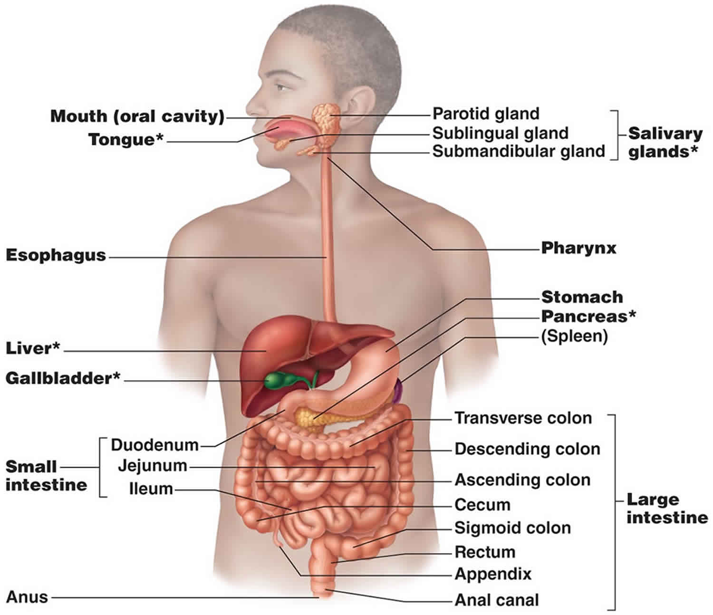
Alimentary Canal or Digestive tract
Gastrointestinal tract, also called digestive tract or alimentary canal, pathway by which food enters the body and solid wastes are expelled. The gastrointestinal tract includes the mouth, pharynx, esophagus, stomach, small intestine, large intestine, and anus

Slide 5
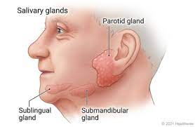

Slide 6
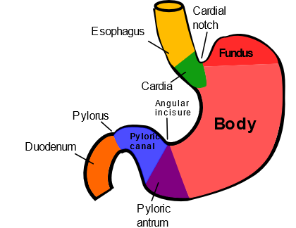
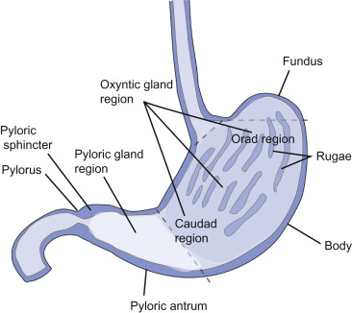
School of Basic and Applied Sciences
Course Code : ENVS1001 Course Name: Environmental Science
Structure of stomach
3
In stomach 2 type of glands available
1. Gastric gland/oxyntic gland: 80 % of stomach cover
2. Pyloric gland : 20 % of stomach
https://www.youtube.com/watch?v=M2_Wa-NU4ZI

Slide 7
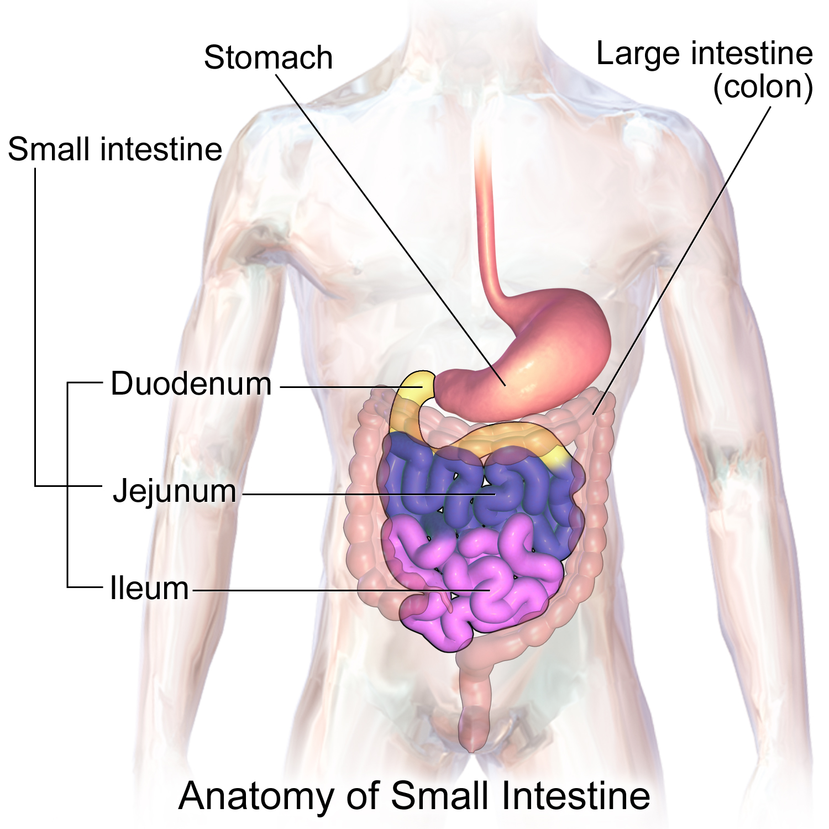
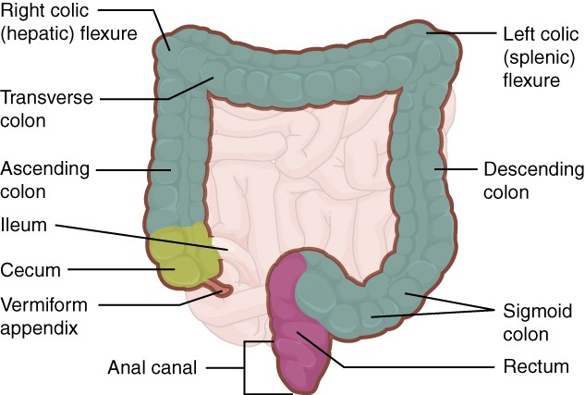
Anatomy of small intestine
Anatomy of large intestine

Slide 8
Steps of Digestion
The digestive processes are ingestion, propulsion, mechanical digestion, chemical digestion, absorption, and defecation (elimination).
Ingested food is chewed, swallowed, and passes through the esophagus into the stomach where it is broken down into a liquid called chyme. Chyme passes from the stomach into the duodenum. There it mixes with bile and pancreatic juices that further break down nutrients. Finger-like projections called villi line the interior wall of the small intestine and absorb most of the nutrients. The remaining chyme and water pass to the large intestine, which completes absorption and eliminates waste.
Muscles contraction in synchronized fashion to move the food forward is called “peristalsis”.
Once it enters the esophagus, food is moved down the esophagus and into our stomach. The

Slide 9
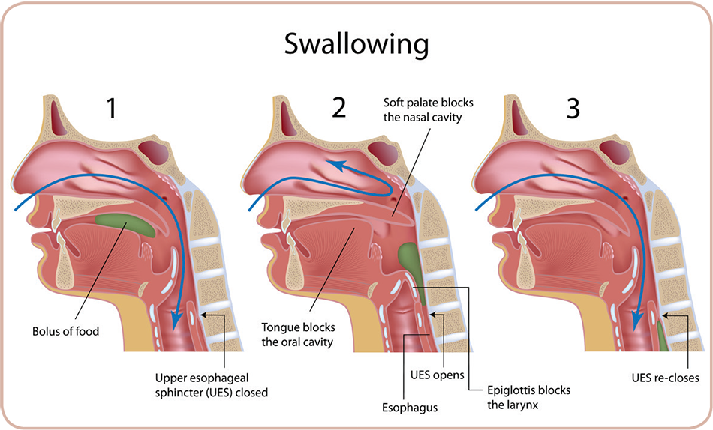
School of Basic and Applied Sciences
Course Code : ENVS1001 Course Name: Environmental Science
Swallowing of food
5
The motility associated with the pharynx and esophagus is swallowing that is the entire process of moving food from the mouth through the esophagus into the stomach.
Swallowing is initiated when a bolus (food + saliva), or ball of chewed or liquid food, is voluntarily forced by the tongue to the rear of the mouth into the pharynx.
The pressure of the bolus stimulates pharyngeal pressure receptors, which send afferent impulses to the swallowing center located in the medulla of the brain stem. The swallowing center then reflex activates in the appropriate sequence the muscles involved in swallowing.
Swallowing is the most complex reflex in the body. Multiple highly coordinated responses are triggered in a specific all-or-none pattern over a period of time to accomplish the act of swallowing.
Swallowing is initiated voluntarily, but once begun it cannot be stopped.

Slide 10
Swallowing on Oropharyngeal stage
7
Swallowing is divided into the oropharyngeal stage and the esophageal stage.
The oropharyngeal stage lasts about 1 second and consists of moving the bolus from the mouth through the pharynx and into the esophagus.
When the bolus enters the pharynx, it must be kept from re-entering the mouth, from entering the nasal passages, and from entering the trachea.
Swallowing is managed by the complex coordinated activities.
Food is prevented from entering the trachea primarily by elevation of the larynx and tight closure of the vocal folds across the laryngeal opening, or glottis.
The first part of the trachea is the larynx, or voice box, across which the vocal folds are stretched. During swallowing, the vocal folds serve a purpose unrelated to speech.
Contraction of laryngeal muscles aligns the vocal folds in tight apposition to each other, thus sealing the glottis entrance

Slide 11
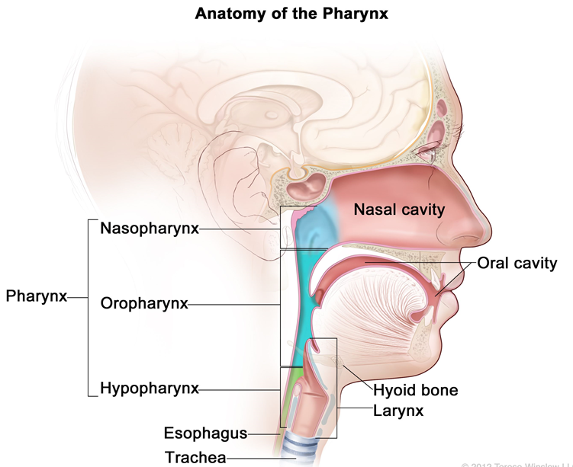
School of Basic and Applied Sciences
Course Code : ENVS1001 Course Name: Environmental Science
Swallowing on Oropharyngeal stage…..
9
The position of the tongue against the hard palate keeps food from re-entering the mouth during swallowing.
The bolus tilts a small flap of cartilaginous tissue, the epiglottis backward down over the closed glottis as further protection from food entering the respiratory airways.
With the larynx and trachea sealed off, pharyngeal muscles contract to force the bolus into the esophagus.

Slide 12
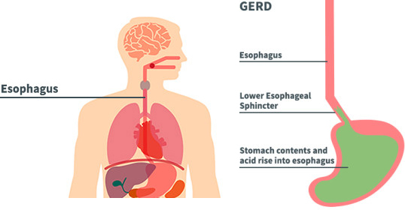
School of Basic and Applied Sciences
Course Code : ENVS1001 Course Name: Environmental Science
Esophagus
10
The esophagus is a fairly straight muscular tube that extends between the pharynx and stomach.
Lying for the most part in the thoracic cavity, it penetrates the diaphragm and joins the stomach in the abdominal cavity a few centimeters below the diaphragm.
The esophagus is guarded at both ends by sphincters. The upper esophageal sphincter is the pharyngoesophageal sphincter, and the lower esophageal sphincter is the gastroesophageal sphincter.
The esophagus is exposed to subatmospheric intrapleural pressure as a result of respiratory activity, a pressure gradient exists between the atmosphere and the esophagus.

Slide 13
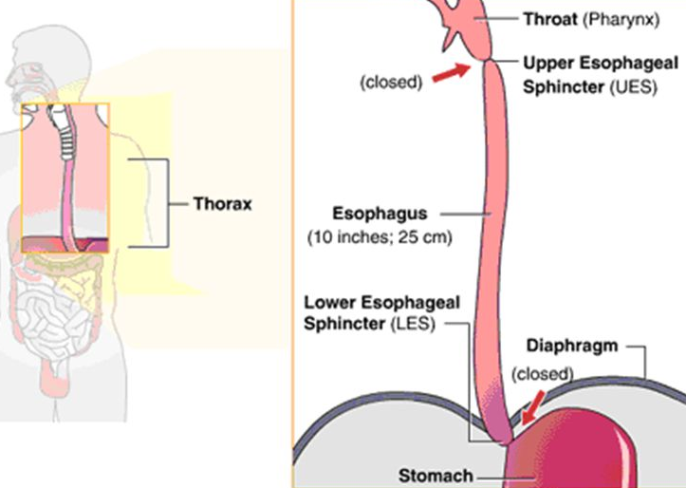
School of Basic and Applied Sciences
Course Code : ENVS1001 Course Name: Environmental Science
pharyngoesophageal sphincter
12
Except during a swallow, the pharyngoesophageal sphincter remains closed as a result of neurally induced contraction of the sphincter’s circular skeletal muscle.
Tonic contraction of this upper esophageal sphincter keeps the entrance to the esophagus closed to prevent large volumes of air from entering the esophagus and stomach during breathing.
Instead, air is directed only into the respiratory airways.
During swallowing, this sphincter opens and allows the bolus to pass into the esophagus.
Once the bolus has entered the esophagus, the pharyngoesophageal sphincter closes, the respiratory airways are opened, and breathing resumes.

Slide 14
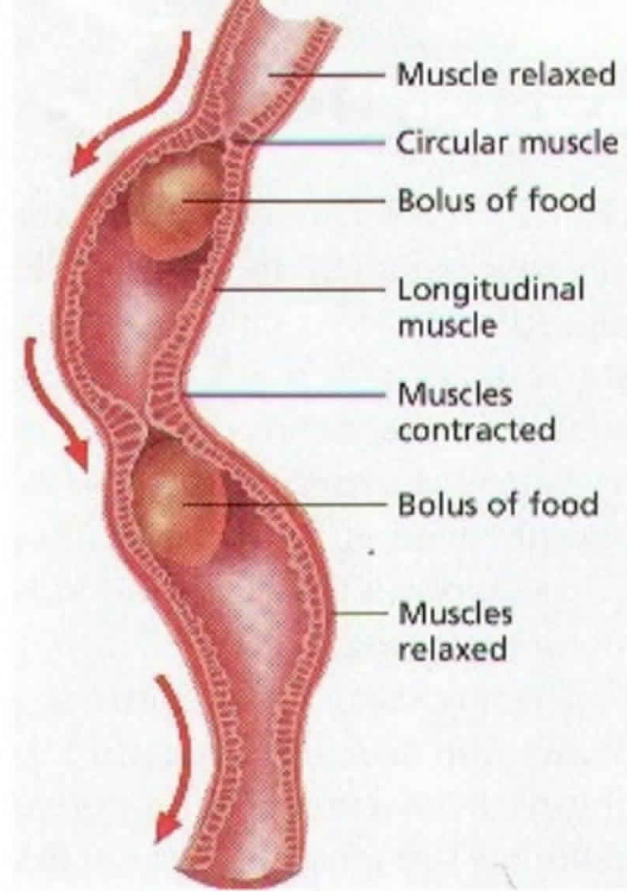
School of Basic and Applied Sciences
Course Code : ENVS1001 Course Name: Environmental Science
Peristaltic Movement
15
After swallowing of the bolus, the swallowing center triggers a primary peristaltic wave that sweeps from the beginning to the end of the esophagus, forcing the bolus ahead of it through the esophagus to the stomach.
The term peristalsis refers to ringlike contractions of the circular smooth muscle that move progressively forward, pushing the bolus into a relaxed area ahead of the contraction.
The peristaltic wave takes about 5 to 9 seconds to reach the lower end of the esophagus.
When the primary peristaltic wave fails to push the a large or sticky swallowed bolus, the lodged bolus distends the esophagus, stimulating pressure receptors within its walls and also reflexly increases salivary secretion.
As a result, a secondary peristaltic waves – a more forceful peristaltic wave is initiated, mediated by the intrinsic nerve plexuses. These waves do not involve the swallowing center, nor is the person aware of their occurrence.

Slide 15
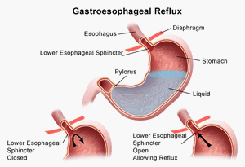
Gastroesophageal sphincter
19
The gastroesophageal sphincter stays tonically contracted by means of myogenic activity to maintain a barrier between the stomach and esophagus, reducing the chance of reflux of acidic gastric contents into the esophagus.
If gastric contents do flow backward despite the sphincter, the acidity of these contents irritates the esophagus, causing the esophageal discomfort known as heartburn.
As the peristaltic wave sweeps down the esophagus, the gastroesophageal sphincter relaxes so that the bolus can pass into the stomach.
After the bolus has entered the stomach, the swallow is complete and this lower esophageal sphincter again contracts.
Mucus is secreted throughout the length of the digestive tract by mucus secreting gland cells in the mucosa. It provides lubrication and protects the esophageal wall from acid and enzymes in gastric juice if gastric reflux occurs.

Slide 16
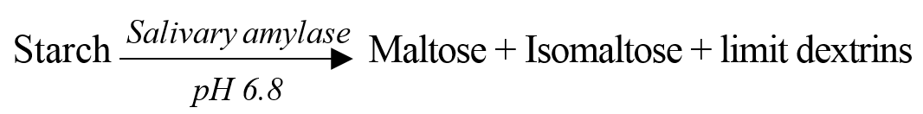
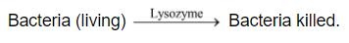
Digestion in Mouth
Start in oral cavity, continues in the stomach and is completed in small intestine.
Food undergoes no change in pharynx and oesophagus (only convey food by swallowing).
Digestion in oral cavity:
Masticated food mixed with saliva from salivary glands.
Digestion of starch (carbohydrates) initiated here.
Nearly 30% hydrolyzed here.
Digestion continues until the bolus reach the stomach.
Bicarbonate ion neutralize the acid present in food.

Slide 17
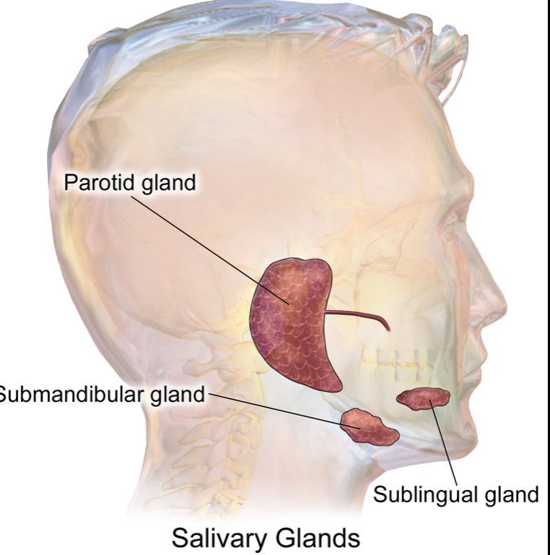
School of Basic and Applied Sciences
Course Code : ENVS1001 Course Name: Environmental Science
Digestive Glands in Mouth
5
Digestion in Buccal cavity:
Salivary glands: 3 pair of Salivary glands in human secrete saliva
Parotid gland
Submandibular/submaxillary gland
Sublingual
The secretion of saliva (salivation) is mediated by parasympathetic stimulation; acetylcholine is the active neurotransmitter and binds to muscarinic receptors in the glands, leading to increased salivation.

Slide 18
Parotid gland
7
1 pair, Open second molar
Serous type secrete ptyalin
Largest salivary gland
Duct called stensen’s duct
Snake poison gland is modification of parotid gland
Infection of parotid gland cause Mumps
20 % of saliva

Slide 19
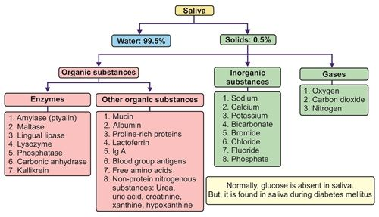
School of Basic and Applied Sciences
Course Code : ENVS1001 Course Name: Environmental Science
Submandibular/submaxillary gland and Sublingual glands
9
Submandibular glands
Serous and mucous type
65-70 % of saliva
Warton’s duct
Beneath the lower jaw superior to digastric muscle
Located about 2 finger above Adam’s apple
Open lower incisor
Sublingual glands
Mucous type mainly
5 % of saliva
Duct of Rivinus
Modified in poison gland in Holoderma gilla monster
Located anterior to submandibular gland and inferior to tongue

Slide 20
School of Basic and Applied Sciences
Course Code : ENVS1001 Course Name: Environmental Science
Secretion of Ions in Saliva
10
Saliva contains especially large quantities of potassium and bicarbonate ions.
Secretion by the submandibular gland: A typical compound gland that contains acini and salivary ducts.
The acini secrete a primary secretion that contains ptyalin and/or mucin in a solution.
As the primary secretion ﬂows through the ducts,
Two major active transport processes take place that markedly modify the ionic composition of the ﬂuid in the saliva.

Slide 21
School of Basic and Applied Sciences
Course Code : ENVS1001 Course Name: Environmental Science
Secretion of Ions in Saliva……
12
First, sodium ions are actively reabsorbed from all the salivary ducts and potassium ions are actively secreted in exchange for the sodium.
Therefore, the sodium ion concentration of the saliva becomes greatly reduced, whereas the potassium ion concentration becomes increased.
However, there is excess sodium reabsorption over potassium secretion, and this creates electrical negativity of about -70 millivolts in the salivary ducts; this in turn causes chloride ions to be reabsorbed passively.
Second, bicarbonate ions are secreted by the ductal epithelium into the lumen of the duct.
This is at least partly caused by passive exchange of bicarbonate for chloride ions, but it may also result partly from an active secretory process.
The net result of these transport processes is that under resting conditions, the concentrations of sodium and chloride ions in the saliva are only about 15 mEq/ L each, the concentration of potassium ions is about 30 mEq/L

Slide 22
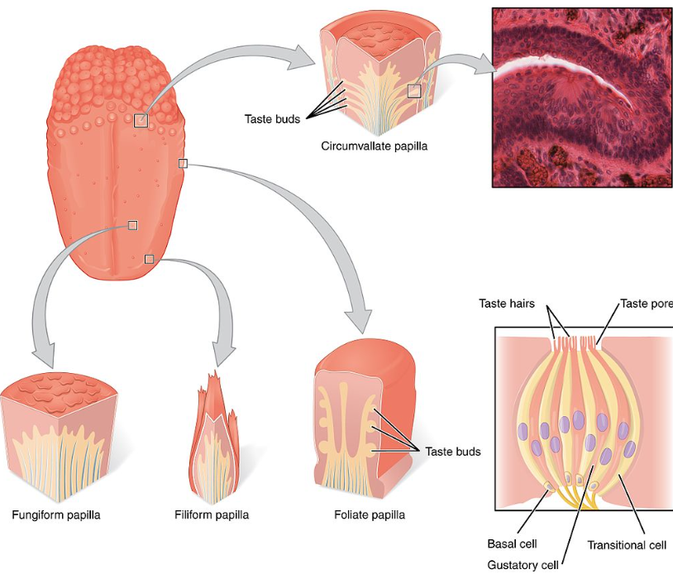
School of Basic and Applied Sciences
Course Code : ENVS1001 Course Name: Environmental Science
Papillae
15
There are three types of lingual papillae that contain taste buds present on the human tongue:
Fungiform papillae - as the name suggests, these are slightly mushroom-shaped
These are present mostly at the dorsal surface of the tongue, as well as at the sides. Innervated by facial nerve.
Foliate papillae - These are ridges and grooves towards the posterior part of the tongue found at the lateral borders. Innervated by facial nerve (anterior papillae) and glossopharyngeal nerve (posterior papillae).
Filiform papillae: do not contain taste buds. They are characterized by increased keratinisation and are involved in the mechanical aspect of providing abrasion.

Slide 23
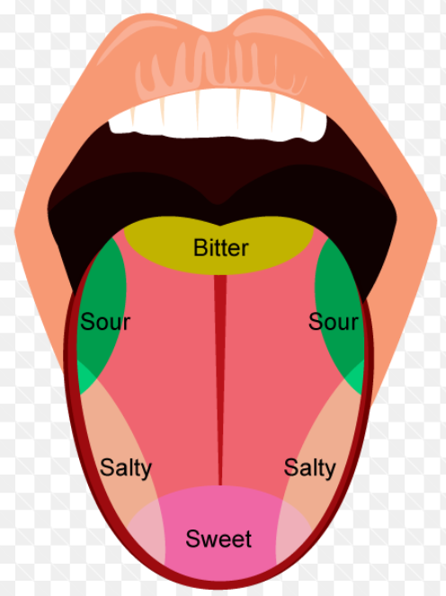
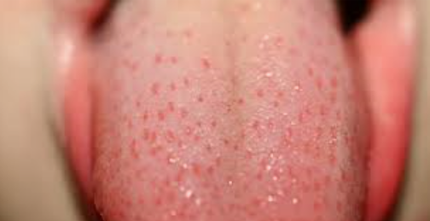
Test Buds
19
Taste buds contain the taste receptor cells, which are also known as gustatory cells.
The taste receptors are located around the small structures known as papillae found on the upper surface of the tongue
five elements of taste perception: salty, sour, bitter, sweet and umami.
Circumvallate papillae - there are only about 10 to 14 of these papillae on most people, and they are present at the back of the oral part of the tongue.
They are arranged in a circular-shaped row just in front of the sulcus terminalis of the tongue.

Slide 24
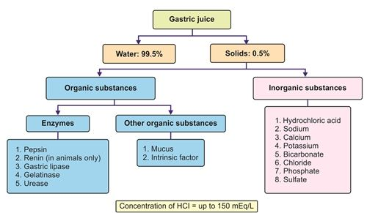
Digestion in Stomach
Stomach: The bolus enters it through the cardiac orifice guarded by cardiac sphincter (regulates the entry of food).
Contraction and expansion of muscles in the wall of stomach bring churning movements.
The secretion of gastric juice takes place in 3 phases:
Cephalic: the sight, smell, taste of food induces reflex stimulation of vagus nerve as a result the GJ secretion occurs much before food enters.
Gastric: The presence of food in stomach stimulates gastric mucosa to produce gastrin hormone.
Stimulates GGs to secrete GJ.
Intestinal:
Goblet cells secrete mucus. Also pyloric tubular glands secrete mucin (lubrication & protection).
Chief/ peptic/ zymogen cells secrete pepsinogen (proenzyme).
In the presence of HCl converted to an active form (autocatalysis).
Hydrolyze proteins to peptides (proteoses and peptones).
Also secrete in infants prorenin (activated by HCl).
Hydrolyze soluble milk protein into paracaesin and whey protein.

Slide 25
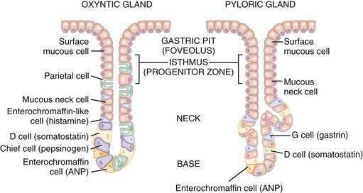
Digestive System in Stomach
A typical adult human stomach is around 30.5 cm long and 15.2 cm wide, with an average capacity of around 1.5 L. It acts simultaneously as a reservoir for ingested food and a mixing and digestion chamber. The inner mucosal lining of the stomach has prominent folds, the rugae, which allow it to expand to up to 50 times its empty volume.
The mucosal lining of the stomach contains around 35 million small depressions, the gastric pits, which produce around 2L of gastric juice per day.
Mucous (or goblet) cells, which produce copious amounts of mucus, protecting the delicate mucosal lining of the stomach. They are known as mucous neck cells;
Parietal cells secrete hydrochloric acid (HCl) and intrinsic factor (IF). HCl is a component of gastric juice, which not only supports chemical digestion but also activates the enzyme pepsin. It is produced at high concentrations, giving the stomach a pH of around 2.5-3.5. This high acidity helps the stomach sterilise ingested food. IF is a small protein that binds to vitamin B12 and transports it across the wall of the intestine into the blood.

Slide 26
Chief cells secrete the inactive enzyme precursor pepsinogen, which is converted into the active enzyme pepsin upon exposure to HCl. Pepsin plays a role in protein digestion and enhances the bacterial killing activity of HCl. Chief cells also secrete gastric lipase, which, together with salivary lipase, initiates fat digestion;
Endocrine cells synthesise various hormones and release them into the blood. As an example, endocrine cells called G cells produce the hormone gastrin, which regulates the secretion of gastric juice.
Secretion of gastric juice
The secretion of gastric juice occurs in three phases:
Cephalic phase
Gastric phase
Intestinal phase

Slide 27
In the cephalic phase, gastric juice secretion is initiated by the sight, smell and taste of food, and is primarily mediated by the parasympathetic nervous system via the vagus nerve, which innervates the stomach wall. The cephalic phase accounts for around 30% of gastric juice secretion and prepares the stomach to receive food.
The gastric phase is the longest phase of gastric juice secretion, typically lasting between two and three hours, and is responsible for around 60% of gastric secretion. It begins when food has entered the stomach and the stomach wall is stretched. This prompts the G cells in the gastric pits to release gastrin. Gastrin stimulates the parietal cells to secrete HCl, which creates a pH favourable for protein digestion and the killing of ingested pathogens.
Gastric juice secretion continues in the intestinal phase while food is slowly passing from the stomach into the duodenum. The duodenum and jejunum progressively release hormones such as cholecystokinin, secretin and gastric-inhibiting peptide, which gradually reduce the secretion of gastric juice . The intestinal phase is responsible for around 10% of gastric juice secretion.

Slide 28
Digestion
Stomach: The bolus enters it through the cardiac orifice guarded by cardiac sphincter (regulates the entry of food).
Contraction and expansion of muscles in the wall of stomach bring churning movements.
The secretion of gastric juice takes place in 2 phases:
Cephalic: the sight, smell, taste of food induces reflex stimulation of vagus nerve as a result the GJ secretion occurs much before food enters.
Gastric: The presence of food in stomach stimulates gastric mucosa to produce gastrin hormone.
Stimulates GGs to secrete GJ.
Goblet cells secrete mucus. Also pyloric tubular glands secrete mucin (lubrication & protection).
Chief/ peptic/ zymogen cells secrete pepsinogen (proenzyme).
In the presence of HCl converted to an active form (autocatalysis).
Hydrolyze proteins to peptides (proteoses and peptones).
Also secrete in infants prorenin (activated by HCl).
Hydrolyze soluble milk protein into paracaesin and whey protein.

Slide 29
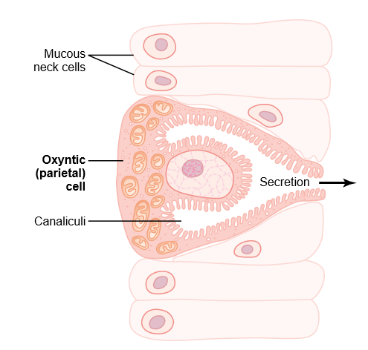
SECRETIONS OF GLANDS
7
Oxyntic gland
Chief cell/peptic cell: pepsinogen
Oxyntic cell/parietal cell: HCl, intrinsic factor
Pyloric gland
Secrete
mucus
Secrete
gastrin
Mucous neck cell: secrete mucin
Hunger contractions, often occurs when the stomach has been empty for several hours or more.
They are rhythmical peristaltic contractions in the body of the stomach
Hunger pangs
When hunger contractions occur in the stomach, the person sometimes experiences mild pain in the pit of the stomach, called hunger pangs.
Hunger pangs usually do not begin until 12 to 24 hours after the last ingestion of food;
In starvation,they reach their greatest intensity in 3 to 4 days and gradually weaken in succeeding days.
Schematic anatomy of the canaliculi in a parietal (oxyntic) cell

Slide 30
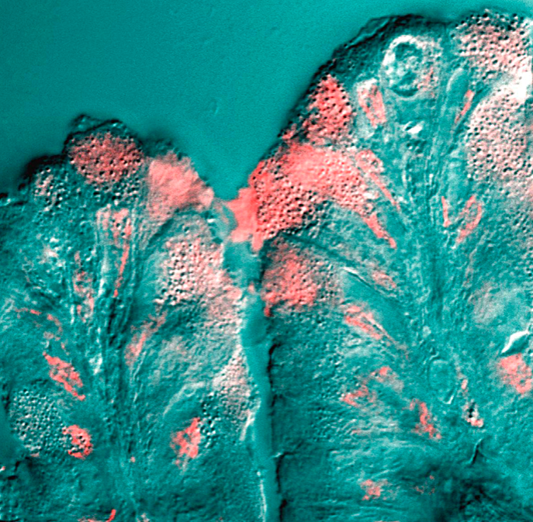
School of Basic and Applied Sciences
Course Code : ENVS1001 Course Name: Environmental Science
Mucous cells of the stomach lining
Mucous cells of the stomach lining secrete mucus (pink) into the lumen
5
It is a viscous colloid containing
Inorganic salts
Antimicrobial enzymes (such as lysozymes)
Immunoglobulins
Glycoproteins such as lactoferrin
Mucin
The amino- and carboxy-terminal regions are very lightly glycosylated, but rich in cysteines.
The cysteine residues participate in establishing disulfide linkages within and among mucin monomers.
A large central region formed of multiple tandem repeats of 10 to 80 residue sequences in which up to half of the amino acids are serine or threonine.
This area becomes saturated with hundreds of O-linked oligosaccharides.
N-linked oligosaccharides are also found on mucins, but in less abundance than O-linked sugars.

Slide 31
School of Basic and Applied Sciences
Course Code : ENVS1001 Course Name: Environmental Science
Regulation of HCl
9
Endocrine regulation
Protein---stomach---stimulate pyloric gland----release gastrin
Gastrin stimulate ECL cell (enterochromaffin like cells)
ECL cell release histamine
Histamine stimulate oxyntic cell secrete HCL
protein
stomach
Pyloric gland
gastrin
ECL cell
2. Vagus nerve
Histamine
acetylcholine
Oxyntic cells
A typical adult human stomach will secrete about 1.5 liters of gastric acid daily
In infants and toddlers gastric juice also contains rennin which cause protein digestion in infants
The pH of gastric acid is 1.5 to 3.5
In the human stomach lumen, the acidity being maintained by the proton pump H⁺/K⁺ ATPase.
The parietal cell releases bicarbonate into the bloodstream in the process, which causes a temporary rise of pH in the blood, known as an alkaline tide.
HCL

Slide 32
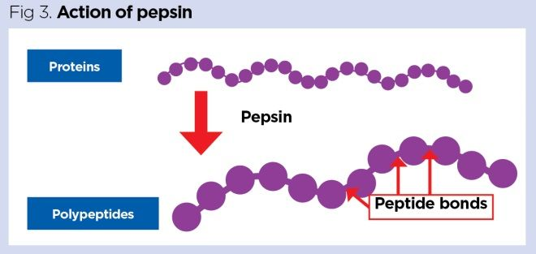
Protein digestion
The process of protein digestion starts in the stomach. HCl slowly denatures proteins (for example, actin and myosin from meat), causing structural changes that expose the peptide bonds between adjacent amino acids. This enhances subsequent chemical digestion by proteases. Activated pepsin present in the gastric juice cleaves the initial protein molecules (which can consist of thousands of amino acids) into smaller chains called polypeptides (Figure). Pepsin is referred to as an endopeptidase because it acts predominantly by attacking the peptide bonds in the centre of proteins to create polypeptides, which are further broken down in subsequent regions of the GI tract.

Slide 33
Fat digestion
The process of fat digestion starts in the mouth when food is mixed with saliva and exposed to the enzyme salivary lipase. However, salivary lipase functions optimally at a pH of around 4, so it will not work at its maximal efficiency in the mouth because, at 6.2-7.6, the pH of saliva is too high. It works at its maximal efficiency upon reaching the acidic environment of the stomach.
In the stomach, fat digestion is amplified by gastric lipase, which is synthesised by the chief cells. Gastric lipase remains stable and active over a broad pH range (2-7); like salivary lipase, however, it functions optimally at a pH of 4-5.4 and so achieves its maximal efficiency in the stomach .
Together, salivary and gastric lipase attack the Ester bonds of fat molecules, breaking down dietary fat into fatty acids and glycerol, however, they are less efficient at digesting fats than the alkaline lipases that will later be released in the small intestine.
Digestion of solid food results in the formation of Semi-solid, thick and soupy material called as Chyme.

Slide 34
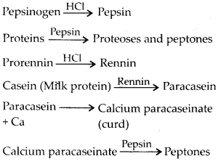
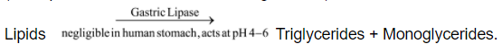
Digestion
Paracaesin spontaneously ppt in +ve of Ca2+ as insoluble calcium paracaesinate, forming soluble curd, or coagulated milk.
Pepsin then converts calcium paracaesinate also in to proteoses, peptones and polypeptides.
GJ also secrete gastric lipase which converts neglible amount of fats into monoglycerides and fatty acids becoz the enzyme is sensitive to free acid and destroyed by HCl. Also stomach lack fat emulsifying agent.

Slide 35
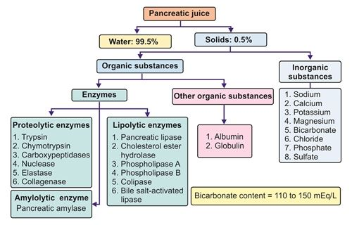
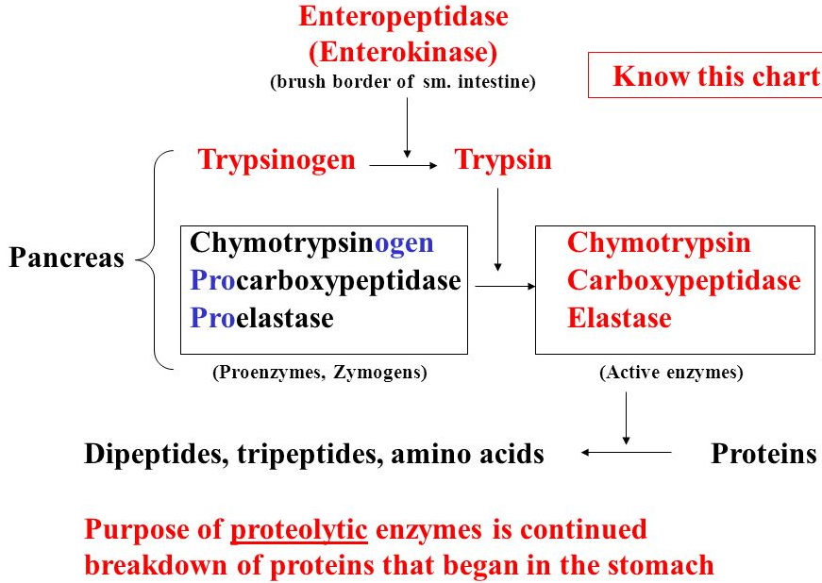
Digestion
Small intestine: The semidigested food from stomach mixed with gastric secretion (chyme) is passed in to duodenum through pyloric sphincter from time to time.
In SI, chyme receive three alkaline secretions, bile (pH 8.0) from liver, pancreatic juice (pH 8.8), and the intestinal juice (pH 8.3). Their alkalinity stop the action of pepsin.
Bile and PJ poured into duodenum from hepato-pancreatic duct.
PJ is secreted by acinar cells.
It contains carbohy. digestive enzyme pancreatic amylase, protein- trypsinogen, chymotrypsinogen and carboxypolypeptidase (inactive form), fat- pancreatic lipase, NAs-, bicarbonates (neutralizes acid of chyme) and water.
Bile contains no enzyme and has no chemical action on food. Sodium glycocholate and sodium taurocholate reduce surface tension of large fat droplets and break them to small one (Emulsification)
Non-digestive
Triglycerides emulsified triglycerides
Emulsified triglycerides 3 fatty acids + glycerol
Starch + glycogen Maltose + Isomaltose + Limit Dextrins

Slide 36
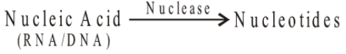
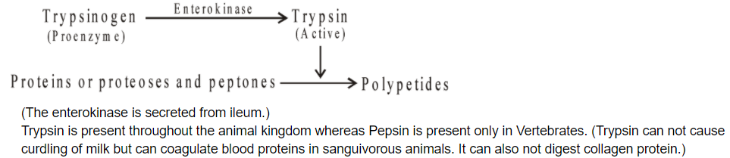
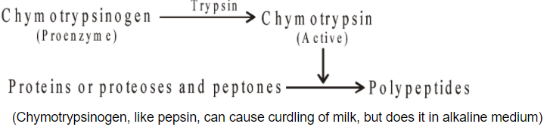
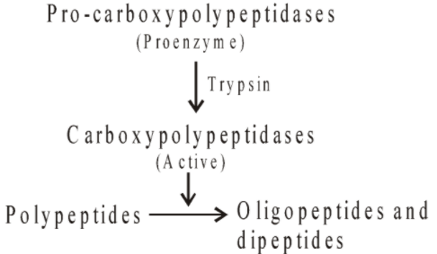
Digestion

Slide 37
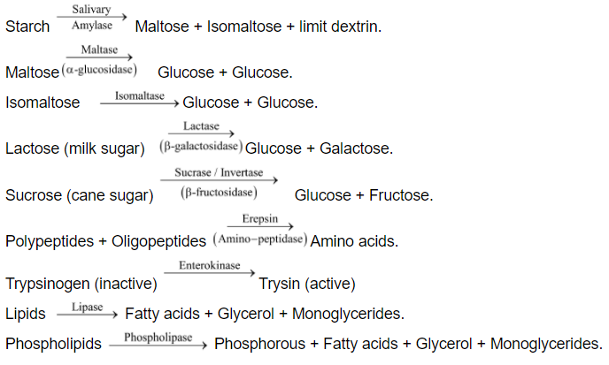
Digestion
Intestinal juice: It contains 6 carbohydrases (intestinal amylase, maltase, isomaltase, limit dextrinase, sucrase and lactase), 2 proteases (aminopeptidases and dipeptidases), a non-digestive enzymes enterokinase, intestinal lipase, nucleic acid digesting enzymes (nucleases, nucleotidases, nucleosidases), mucus, carbonates and water.
Limit dextrin Glucose
Peptides Dipeptides + AAs
Dipeptides AAs

Slide 38
School of Basic and Applied Sciences
Course Code : ENVS1001 Course Name: Environmental Science
Digestion in Small intestine
12
Duodenum and jejunum wall act as endocrine gland and secrete hormones
Cholecystokinin
Secretin
Pancreozymin
1. Cholecystokinin: Stimulate pancreas and liver for pancreatic juice and bile juice
cholecystokinin, a polypeptide containing 33 amino acids, to be released from yet another group of cells, the I cells, in the mucosa of the duodenum and upper jejunum.
This release of cholecystokinin results especially from the presence of proteoses and peptones (products of partial protein digestion) and long-chain fatty acids in the chyme coming from the stomach.

Slide 39
School of Basic and Applied Sciences
Course Code : ENVS1001 Course Name: Environmental Science
Digestive Enzymes in the Small Intestinal Secretion
24
The enterocytes of the mucosa, especially those that cover the villi, do contain digestive enzymes that digest speciﬁc food substances while they are being absorbed through the epithelium.
These enzymes are the following:
(1) several peptidases for splitting small peptides into amino acids,
(2) four enzymes—sucrase, maltase, isomaltase, and lactase—for splitting disaccharides into monosaccharides,
(3) small amounts of intestinal lipase for splitting neutral fats into glycerol and fatty acids.

Slide 40
School of Basic and Applied Sciences
Course Code : ENVS1001 Course Name: Environmental Science
2. Secretin
15
It Stimulates Secretion of Copious Quantities of Bicarbonate Ions—Neutralization of Acidic Stomach Chyme.
Secretin is a polypeptide, containing 27 amino acids (molecular weight about 3400), present in an inactive form, prosecretin, in so-called S cells in the mucosa of the duodenum and jejunum.
When acid chyme with pH less than 4.5 to 5.0 enters the duodenum from the stomach, it causes duodenal mucosal release and activation of secretin, which is then absorbed into the blood.
The one truly potent constituent of chyme that causes this secretin release is the hydrochloric acid from the stomach
Secretin cause pancrease large quantities of ﬂuid containing a high concentration of bicarbonate ion (up to 145 mEq/L) but a low concentration of chloride ion.
The secretin release increases greatly as the pH falls to 3.0.
This immediately causes copious secretion of pancreatic juice containing abundant amounts of sodium bicarbonate.
The net result is then the following reaction in the duodenum:
Then the carbonic acid immediately dissociates into carbon dioxide and water. The carbon dioxide is absorbed into the blood and expired through the lungs, thus leaving a neutral solution of sodium chloride in the duodenum.
Bicarbonate ion secretion by the pancreas provides an appropriate pH for action of the pancreatic digestive enzymes, which function optimally in a slightly alkaline or neutral medium, at a pH of 7.0 to 8.0.
The pH of the sodium bicarbonate secretion averages 8.0.

Slide 41
Three accessory digestive organs (pancreas, liver, gallbladder)
Pancreas: Although the pancreas is mostly known for its blood sugar regulatory function with the production of insulin (as part of the endocrine system -- the insulin goes directly from the gland into the bloodstream), it is the main producer of digestive enzymes as part of the exocrine system (the enzymes produced by the gland pass through a duct into the intestines). These enzymes are released into the duodenum and help with the digestion of fats, proteins, and carbohydrates..
Liver: The liver produces bile for fat digestion and elimination. In addition, nutrients are stored in the liver, and toxins and chemicals are filtered by liver.
Gallbladder: Bile is stored and released from the gallbladder. When fatty food enters the duodenum, the gallbladder contracts and releases bile.

Slide 42
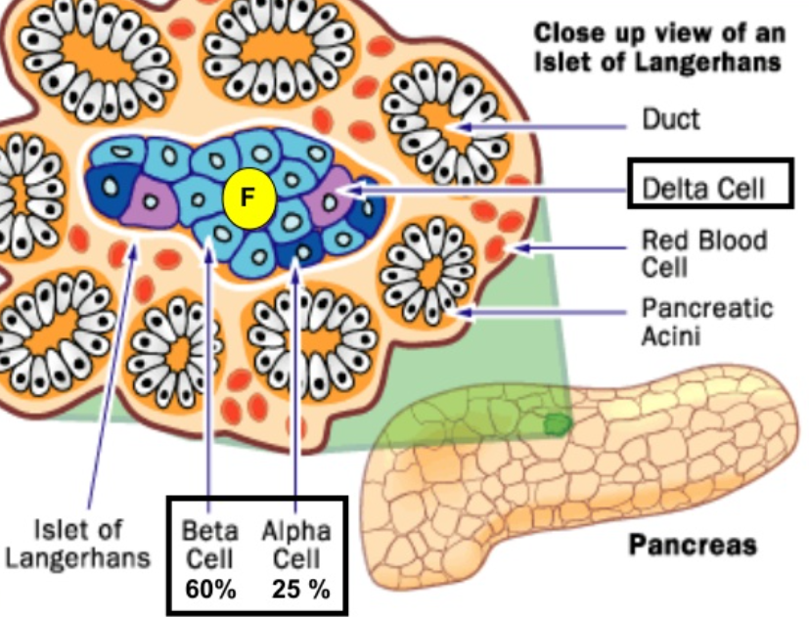
Pancreatic juice
19
The pancreas, which lies parallel to and beneath the stomach is a large compound gland
The pancreatic digestive enzymes are secreted by pancreatic acini, and large volumes of sodium bicarbonate solution are secreted by the small ductules and larger ducts leading from the acini.
The combined product of enzymes and sodium bicarbonate then ﬂows through a long pancreatic duct that normally joins the hepatic duct immediately before it empties into the duodenum through the papilla of Vater, surrounded by the sphincter of Oddi.
The pancreas is a mixed gland, having both an endocrine and an exocrine function.
As an endocrine gland, it secretes into the blood several important hormones, including insulin, glucagon, somatostatin and pancreatic polypeptide.
As an exocrine gland, it secretes pancreatic juice into the duodenum through the pancreatic duct.

Slide 43
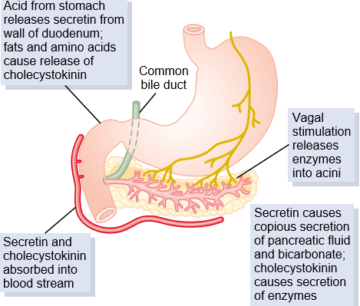
School of Basic and Applied Sciences
Course Code : ENVS1001 Course Name: Environmental Science
Pancreatic secretion
21
Pancreatic secretion contains multiple enzymes for digesting all of the three major types of food: proteins, carbohydrates, and fats.
It also contains large quantities of bicarbonate ions, which play an important role in neutralizing the acidity of the chyme emptied from the stomach into the duodenum.
Protein digestion in duodenum and jejunum (small intestine)
The most important of the pancreatic enzymes for digesting proteins are
trypsin, secreted as Trypsinogen
chymotrypsin, secreted as chymotrypsinogen
carboxypolypeptidase. secreted as pro carboxypolypeptidase
Trypsinogen is activated by an enzyme called enterokinase,
which is secreted by the intestinal mucosa when chyme comes
in contact with the mucosa.
The most abundant of these is trypsin.
Trypsin and chymotrypsin split whole and partially digested proteins into peptides of various sizes
Proteins--- trpsin and chymotrypsin------peptides
Peptides---------carboxypeptidase----amino acid

Slide 44
School of Basic and Applied Sciences
Course Code : ENVS1001 Course Name: Environmental Science
Bile juice
24
Secretion of Bile by the Liver
liver is to secrete bile, normally between 600 and 1000 ml/day.
Bile serves two important functions: First, bile plays an important role in fat digestion and absorption,
Bile acids in the bile do two things:
They help to emulsify the large fat particles of the food into many minute particles, the surface of which can then be attacked by lipase enzymes secreted in pancreatic juice,
(2) they aid in absorption of the digested fat end products through the
intestinal mucosal membrane.
Second Bile help excretion of several important waste products from the blood.
These include especially bilirubin, and end product of hemoglobin destruction, and excesses of cholesterol
Composition of bile:
The composition of hepatic bile is 97% water, 0.7% bile salts, 0.2% bilirubin, 0.51% fats (cholesterol, fatty acids, and lecithin), and 200 meq/l inorganic salts.

Slide 45
Food absorption
The stomach is not a major area of nutrient absorption. There is minimal absorption of the initial products of protein digestion and it is generally thought that digested fat is not absorbed at in the stomach. However, simple sugars such as glucose, galactose and fructose are readily absorbed, particularly when in high concentration. The stomach is excellent at absorbing water, taking approximately 20 minutes to absorb 50% of the ingested volume of water. Similarly, the ethanol present in alcoholic beverages is rapidly absorbed across the gastric wall into the blood.
Villi that line the walls of the small intestine absorb nutrients into capillaries of the circulatory system and lacteals of the lymphatic system. Villi contain capillary beds, as well as lymphatic vessels called lacteals. Fatty acids absorbed from broken-down chyme pass into the lacteals. Other absorbed nutrients enter the bloodstream through the capillary beds and are taken directly to the liver, via the hepatic vein, for processing

Slide 46
The Large Intestine Completes Absorption and Compacts Waste
Chyme passes from the small intestine through the ileocecal valve and into the cecum of the large intestine. Any remaining nutrients and some water are absorbed as peristaltic waves move the chyme into the ascending and transverse colons. This dehydration, combined with peristaltic waves, helps compact the chyme. The solid waste formed is called feces. It continues to move through the descending and sigmoid colons. The large intestine temporarily stores the feces prior to elimination.
Defecation Eliminates Waste From the Body
The body expels waste products from digestion through the rectum and anus. This process, called defecation, involves contraction of rectal muscles, relaxation of the internal anal sphincter, and an initial contraction of the skeletal muscle of the external anal sphincter. The defecation reflex is mostly involuntary, under the command of the autonomic nervous system. But the somatic nervous system also plays a role to control the timing of elimination.

Slide 47
School of Basic and Applied Sciences
Course Code : BBS01T1008 Course Name: Biology of Engineers
Reference Text Books
Source & References:
The materials presented in this lecture has been taken from various books and internet websites. This instruction materials is for instructional purposes only.
Sherwood L. Human physiology: from cells to systems. Cengage learning; 2015.
Hall JE, Hall ME. Guyton and Hall textbook of medical physiology e-Book. Elsevier Health Sciences; 2020 Jun 13.
Silverthorn DU, Ober WC, Garrison CW, Silverthorn AC, Johnson BR. Human physiology: an integrated approach. San Francisco: Pearson/Benjamin Cummings; 2010.
Stanfield CL, Germann WJ, Niles MJ, Cannon JG. Principles of human physiology. Benjamin Cummings; 2011 Nov 21.
Carpenter WB. Principles of human physiology. Lea & Blanchard; 1866.
https://www.youtube.com/watch?v=M2_Wa-NU4ZI

Slide 48
School of Basic & Applied Sciences
Course Code : BBS01T1008 Course Name: Biology for Engineers
Learning Outcomes
Structure of brain
Neurons
Name of the Faculty: Dr. Anjali Gupta Program Name: : B.Tech. Ist sem

Slide 49
Brain
School of Basic & Applied Sciences
Course Code : BBS01T1008 Course Name: Biology for Engineers
largest organs in the body.
coordinates most body activities
center for all thought, memory, judgment, and emotion.
responsible for controlling different body functions, such as temperature regulation and breathing.
Name of the Faculty: Dr. Anjali Gupta Program Name: : B.Tech. Ist sem

Slide 50
School of Basic & Applied Sciences
Course Code : BBS01T1008 Course Name: Biology for Engineers
BRAIN
The brain is contained in skull & weighs 1300 - 1400 g.
made up of about 1000 billion neurons.
each neuron is surrounded by about 10 glial cells (neuroglia ).
Name of the Faculty: Dr. Anjali Gupta Program Name: : B.Tech. Ist sem

Slide 51
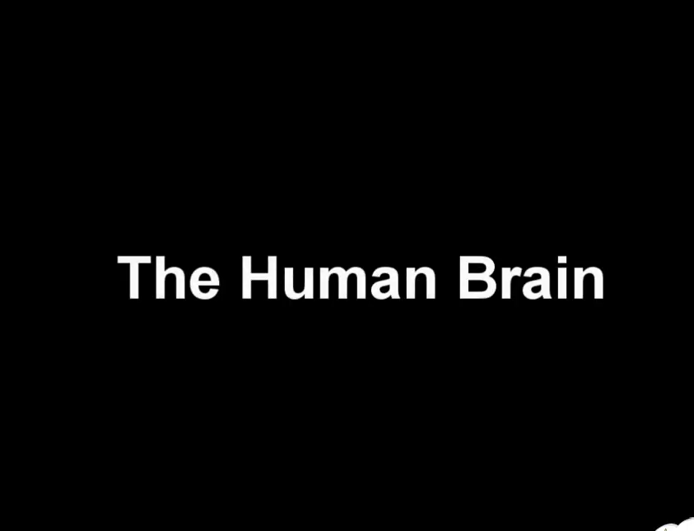
School of Basic & Applied Sciences
Course Code : BBS01T1008 Course Name: Biology for Engineers
Name of the Faculty: Dr. Anjali Gupta Program Name: : B.Tech. Ist sem

Slide 52
School of Basic & Applied Sciences
Course Code : BBS01T1008 Course Name: Biology for Engineers
BRAIN
Neurons cannot multiply & many neurons are lost everyday in life but glial cells can multiply throughout the life.
B) Brain is also covered by “Meninges” like spinal cord---outer duramater, middle arachnoidmater & inner piamater
Name of the Faculty: Dr. Anjali Gupta Program Name: : B.Tech. Ist sem

Slide 53
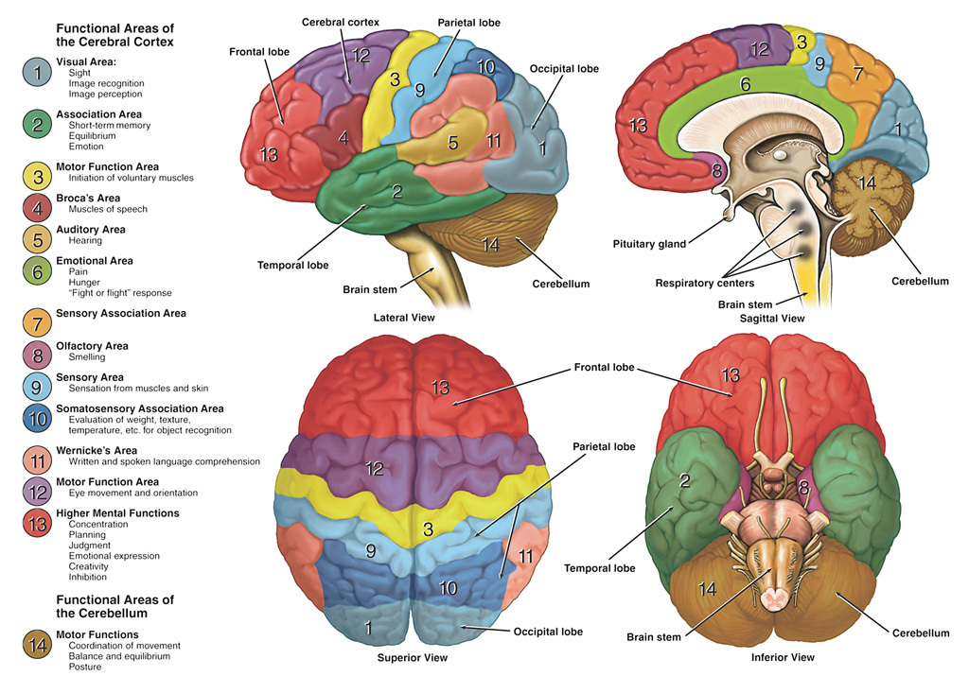
School of Basic & Applied Sciences
Course Code : BBS01T1008 Course Name: Biology for Engineers
Name of the Faculty: Dr. Anjali Gupta Program Name: : B.Tech. Ist sem

Slide 54
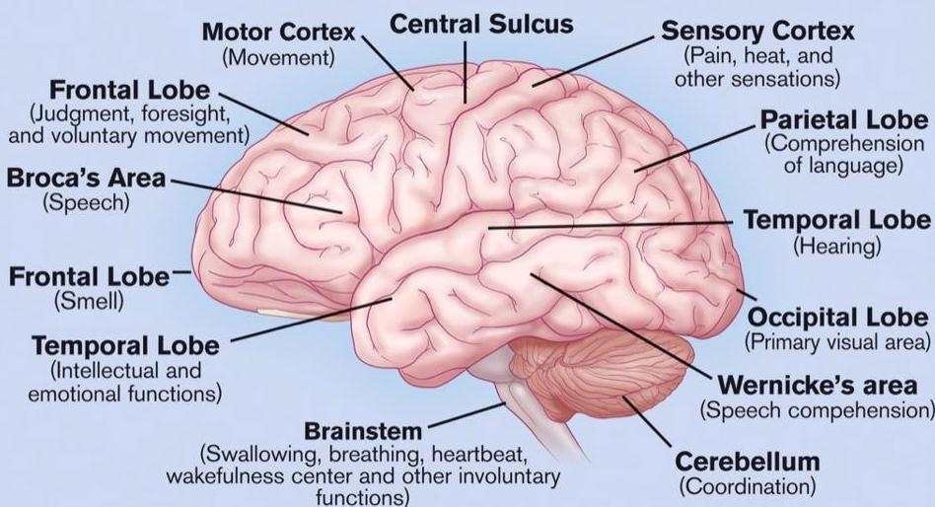
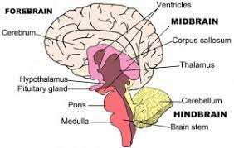
School of Basic & Applied Sciences
Course Code : BBS01T1008 Course Name: Biology for Engineers
STRUCTURE OF BRAIN
Name of the Faculty: Dr. Anjali Gupta Program Name: : B.Tech. Ist sem

Slide 55
School of Basic & Applied Sciences
Course Code : BBS01T1008 Course Name: Biology for Engineers
FOREBRAIN
Cerebrum and Cerebral cortex
Left and Right Hemispheres
Left hemisphere for most people is the dominant
hemisphere- responsible for production of language,
mathematical ability, problem solving, logic
Right hemisphere thought to be responsible for creativity
and spatial ability.
Name of the Faculty: Dr. Anjali Gupta Program Name: B.Tech. Ist sem

Slide 56
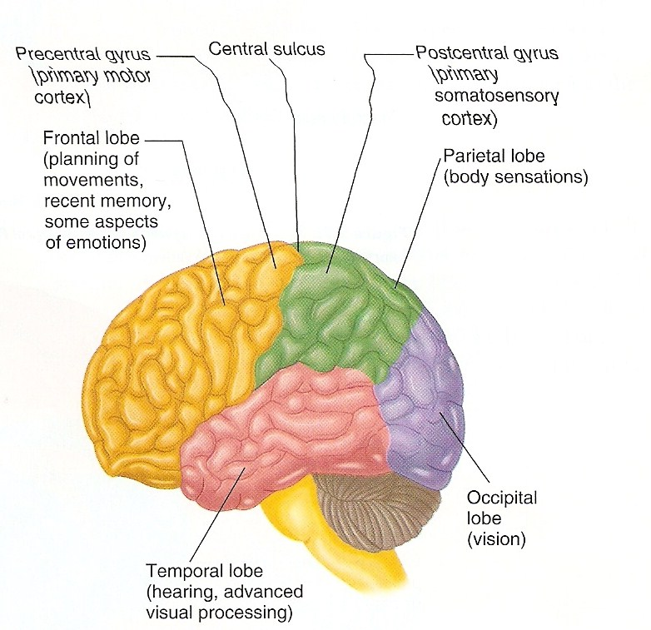
School of Basic & Applied Sciences
Course Code : BBS01T1008 Course Name: Biology for Engineers
STRUCTURE OF FOREBRAIN
Name of the Faculty: Dr. Anjali Gupta Program Name: : B.Tech. Ist sem

Slide 57
School of Basic & Applied Sciences
Course Code : BBS01T1008 Course Name: Biology for Engineers
FRONTAL LOBE
Responsible for Personality, behavior, emotions
Judgment, planning, problem solving
Speech: speaking and writing (Broca’s area)
Body movement (motor strip)
Intelligence, concentration, self awareness
Name of the Faculty: Dr. Anjali Gupta Program Name: : B.Tech. Ist sem

Slide 58
School of Basic & Applied Sciences
Course Code : BBS01T1008 Course Name: Biology for Engineers
Parietal Lobe
Located behind frontal lobe
Somatosensory cortex (responsible for receiving and processing sensory information from across the body)
Spatial orientation, perception and comprehension of language function recognising object by touch
Links visual and somatosensory information together
Name of the Faculty: Dr. Anjali Gupta Program Name: : B.Tech. Ist sem

Slide 59
School of Basic & Applied Sciences
Course Code : BBS01T1008 Course Name: Biology for Engineers
Temporal Lobes
Located at each side of the brain
Involved in receiving and processing auditory information , higher order visual information, complex aspects of memory and language
Wernicke’s Area- Comprehension of speech
Name of the Faculty: Dr. Anjali Gupta Program Name: B.Tech. Ist sem

Slide 60
School of Basic & Applied Sciences
Course Code : BBS01T1008 Course Name: Biology for Engineers
Occipital Lobes
Rearmost portion of the brain
Visual processing area
Corpus Callosum- Fibre bundle in the brain that connects the two hemispheres together.
Name of the Faculty: Dr. Anjali Gupta Program Name: : B.Tech. Ist sem

Slide 61
School of Basic & Applied Sciences
Course Code : BBS01T1008 Course Name: Biology for Engineers
Thalamus- filters sensory information, controls mood states and body movement associated with emotive states.
Hypothalamus- ‘Central control’ for pituitary gland. Regulates autonomic, emotional, endocrine and somatic function. Has a direct involvement in stress and mood states.
Name of the Faculty: Dr. Anjali Gupta Program Name: : B.Tech. Ist sem

Slide 62
School of Basic & Applied Sciences
Course Code : BBS01T1008 Course Name: Biology for Engineers
Cerebellum- regulates equilibrium, muscle tone, postural control, fine movement and coordination of voluntary muscle movement.
Pons- Relay station between cerebrum and cerebellum.
Name of the Faculty: Dr. Anjali Gupta Program Name: : B.Tech. Ist sem

Slide 63
School of Basic & Applied Sciences
Course Code : BBS01T1008 Course Name: Biology for Engineers
Neurons
- Neurons, also known as nerve cells, send and receive signals from your brain. While neurons have a lot in common with other types of cells, they’re structurally and functionally unique.
Specialized projections called axons allow neurons to transmit electrical and chemical signals to other cells. Neurons can also receive these signals via root like extensions known as dendrites.
- Neurons vary in size, shape, and structure depending on their role and location. However, nearly all neurons have three essential parts: a cell body, an axon, and dendrites.
Name of the Faculty: Dr. Anjali Gupta Program Name: : B.Tech. Ist sem

Slide 64
References
School of Basic & Applied Sciences
Course Code : BBS01T1008 Course Name: Biology for Engineers
www.med.monash.edu.au
2. The brain (slideshare.net).
3. How the Brain Works | Johns Hopkins Comprehensive Brain Tumor Center (hopkinsmedicine.org)
4. http://training.seer.cancer.gov/module_anatomy/unit5_3_nerve_org1_cns.html)
5. Biology - 3D animation - Human Brain Overview ( Senior) - English - YouTube
Name of the Faculty: Dr. Anjali Gupta Program Name: : B.Tech. Ist sem

Slide 65
School of Basic & Applied Sciences
Course Code : BBS01T1008 Course Name: Biology for Engineers
Physiology of nerve impulse conduction, excitability of membranes, electrical and chemical transmission between cells
Name of the Faculty: Dr. Anjali Gupta Program Name: B.Tech. Ist sem

Slide 66
School of Basic & Applied Sciences
Course Code : BBS01T1008 Course Name: Biology for Engineers
Prerequisites
Knowledge of basic structure of cell
Structure of neuron
Structure of brain
Name of the Faculty: Dr. Anjali Gupta Program Name: : B.Tech. Ist sem

Slide 67
School of Basic & Applied Sciences
Course Code : BBS01T1008 Course Name: Biology for Engineers
RECAP
General physiology
Structure of neuron
Structure of brain
Name of the Faculty: Dr. Anjali Gupta Program Name: : B.Tech. Ist sem

Slide 68
School of Basic & Applied Sciences
Course Code : BBS01T1008 Course Name: Biology for Engineers
Learning Outcomes
Physiology of nerve impulse conduction
excitability of membranes
electrical and chemical transmission between cells
Name of the Faculty: Dr. Anjali Gupta Program Name: : B.Tech. Ist sem

Slide 69
School of Basic & Applied Sciences
Course Code : BBS01T1008 Course Name: Biology for Engineers
Neurons
- Neurons, also known as nerve cells, send and receive signals from your brain. While neurons have a lot in common with other types of cells, they’re structurally and functionally unique.
Specialized projections called axons allow neurons to transmit electrical and chemical signals to other cells. Neurons can also receive these signals via rootlike extensions known as dendrites.
Name of the Faculty: Dr. Anjali Gupta Program Name: : B.Tech. Ist sem

Slide 70
School of Basic & Applied Sciences
Course Code : BBS01T1008 Course Name: Biology for Engineers
Neurons
- Neurons vary in size, shape, and structure depending on their role and location. However, nearly all neurons have three essential parts: a cell body, an axon, and dendrites.
Name of the Faculty: Dr. Anjali Gupta Program Name: : B.Tech. Ist sem

Slide 71
Function of neurons
School of Basic & Applied Sciences
Course Code : BBS01T1008 Course Name: Biology for Engineers
Chemical synapses
In a chemical synapse, action potentials affect other neurons via a gap between neurons called a synapse. Synapses consist of a presynaptic ending, a synaptic cleft, and a postsynaptic ending.
When an action potential is generated, it’s carried along the axon to a presynaptic ending. This triggers the release of chemical messengers called neurotransmitters. These molecules cross the synaptic cleft and bind to receptors in the postsynaptic ending of a dendrite.
Neurotransmitters can excite the postsynaptic neuron, causing it to generate an action potential of its own. Alternatively, they can inhibit the
postsynaptic neuron, in which case it doesn’t generate an action
potential.
Name of the Faculty: Dr. Anjali Gupta Program Name: : B.Tech. Ist sem

Slide 72
School of Basic & Applied Sciences
Course Code : BBS01T1008 Course Name: Biology for Engineers
Electrical synapses
Electrical synapses can only excite. They occur when two neurons are connected via a gap junction. This gap is much smaller than a synapse, and includes ion channels which facilitate the direct transmission of a positive electrical signal. As a result, electrical synapses are much faster than chemical synapses. However, the signal diminishes from one neuron to the next, making them less effective at transmitting.
Name of the Faculty: Dr. Anjali Gupta Program Name: : B.Tech. Ist sem

Slide 73
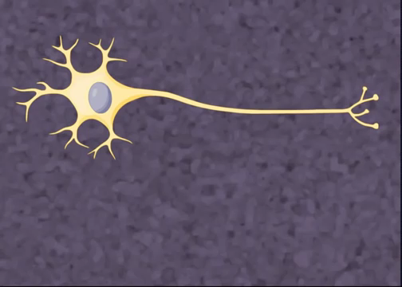
School of Basic & Applied Sciences
Course Code : BBS01T1008 Course Name: Biology for Engineers
Name of the Faculty: Dr. Anjali Gupta Program Name: : B.Tech. Ist sem

Slide 74
School of Basic & Applied Sciences
Course Code : BBS01T1008 Course Name: Biology for Engineers
Types of neurons
Neurons vary in structure, function, and genetic makeup. Given the sheer number of neurons, there are thousands of different types, much like there are thousands of species of living organisms on Earth.
In terms of function, scientists classify neurons into three broad types: sensory, motor, and interneurons.
Name of the Faculty: Dr. Anjali Gupta Program Name: : B.Tech. Ist sem

Slide 75
School of Basic & Applied Sciences
Course Code : BBS01T1008 Course Name: Biology for Engineers
Sensory neurons
Sensory neurons help in:
taste
smell
hear
See
Feel things around
Name of the Faculty: Dr. Anjali Gupta Program Name: : B.Tech. Ist sem

Slide 76
School of Basic & Applied Sciences
Course Code : BBS01T1008 Course Name: Biology for Engineers
Motor Neurons
Motor neurons play a role in movement, including voluntary and involuntary movements. These neurons allow the brain and spinal cord to communicate with muscles, organs, and glands all over the body.
There are two types of motor neurons: lower and upper. Lower motor neurons carry signals from the spinal cord to the smooth muscles and the skeletal muscles. Upper motor neurons carry signals between your brain and spinal cord.
Name of the Faculty: Dr. Anjali Gupta Program Name: B.Tech. Ist sem

Slide 77
School of Basic & Applied Sciences
Course Code : BBS01T1008 Course Name: Biology for Engineers
INTERNEURONS
Interneurons are neurons that connect two brain regions, i.e. not direct motor neurons or sensory neurons. Interneurons are the central nodes of neural circuits, enabling communication between sensory or motor neurons and the central nervous system. They play vital roles in reflexes, neuronal oscillations, and neurogenesis in the adult mammalian brain..
Name of the Faculty: Dr. Anjali Gupta Program Name: : B.Tech. Ist sem

Slide 78
School of Basic & Applied Sciences
Course Code : BBS01T1008 Course Name: Biology for Engineers
Nerve impulse conduction
Nerve impulse: Nerve impulse is an overall physiological
changes that occur in a neuron due mechanical, chemical or electrical
disturbance created by a stimulus. It propagation through axon, synapse
and neuromuscular junction is called Nerve Impulse conduction.
Name of the Faculty: Dr. Anjali Gupta Program Name: : B.Tech. Ist sem

Slide 79
School of Basic & Applied Sciences
Course Code : BBS01T1008 Course Name: Biology for Engineers
Nerve impulse conduction
Transmission of nerve impulse along nerve fibre can be summarized in three steps:
Polarization (Resting Potential)
Depolarization (Action Potential)
Repolarization
Name of the Faculty: Dr. Anjali Gupta Program Name: : B.Tech. Ist sem

Slide 80
School of Basic & Applied Sciences
Course Code : BBS01T1008 Course Name: Biology for Engineers
Polarization (Resting Potential)
A neuron at resting is electrically charged but not conducting.
The Axoplasm or plasma membrane of a resting neuron is negatively charged as compared to the interstitial fluid.
The potential difference measured at this stage is called resting potential which is about -70mV. The interstitial fluid has high concentration of Na+ ion which is about 16 times higher outside the neuron than inside neuron. Similarly, the axoplasm has high concentration of K+ ion which is about 25 times higher inside than in outer interstitial fluids.
This state of resting neuron is called Polarized state and it is
electro-negatively charged.
Name of the Faculty: Dr. Anjali Gupta Program Name: B.Tech. Ist sem

Slide 81
School of Basic & Applied Sciences
Course Code : BBS01T1008 Course Name: Biology for Engineers
Depolarization (Action Potential)
Any stimulus beyond the threshold can initiate an impulse.
When such stimulus is applied in the resting neuron, it opens the sodium channel. Now the permeability of Na+ ion suddenly increases at the point of stimulus causing depolarization.
The diffusion of Na+ ion increases by 10 times from outside to inside. As a result the axoplasm become positively charges, which is exact opposite to polarized state, so called as depolarized state or reverse polarized state.
The depolarization of the membrane stimulates the adjacent voltage channel, so the action potential passes as a wave along the length of neuron.
Name of the Faculty: Dr. Anjali Gupta Program Name: : B.Tech. Ist sem

Slide 82
School of Basic & Applied Sciences
Course Code : BBS01T1008 Course Name: Biology for Engineers
Repolarization
When the concentration of Na+ ion inside axoplasm increases, the permeability to Na+ decreases and the sodium channel starts to close.
The Na-K pump activates, so that Na+ are pumped out and K+ inside until the original resting potential is restored. The process is known as repolarization and it starts from the same point from where depolarization starts.
The entire process of polarization, depolarization and repolarization occur within fraction of seconds. Now, again the neuron is read for another impulse.
Name of the Faculty: Dr. Anjali Gupta Program Name: : B.Tech. Ist sem

Slide 83
School of Basic & Applied Sciences
Course Code : BBS01T1008 Course Name: Biology for Engineers
Excitability of membranes
Excitability of a cardiac cell depends on the passive and active properties of the cell membrane. The passive properties include the membrane resistance and capacitance and the intercellular resistance. The most important determinant of reduced excitability is the reduced availability of Na + channels.
Name of the Faculty: Dr. Anjali Gupta Program Name: : B.Tech. Ist sem

Slide 84
School of Basic & Applied Sciences
Course Code : BBS01T1008 Course Name: Biology for Engineers
Electrical and chemical transmission between cells
Chemical and electrical synapses are specialized biological structures found in the nervous system; they connect neurons together and transmit signals across the neurons. The key difference between chemical and electrical synapse is their method of transmitting signals; chemical synapse pass signals in the form of chemical molecules called neurotransmitters while electrical synapse transmits signals in the form of electrical signals without the use of molecules. The structure of chemical synapse and electrical synapse is also slightly different from each other due to their mode of action.
Name of the Faculty: Dr. Anjali Gupta Program Name: : B.Tech. Ist sem

Slide 85
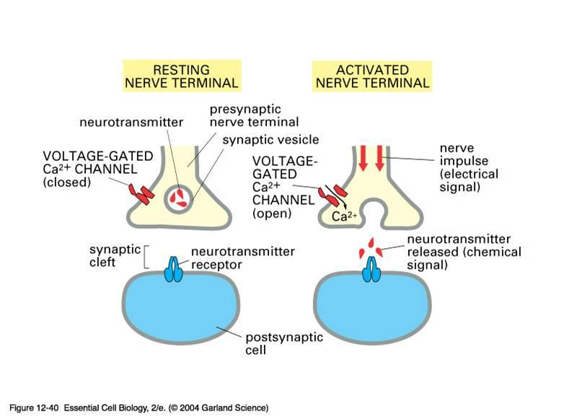
School of Basic & Applied Sciences
Course Code : BBS01T1008 Course Name: Biology for Engineers
Electrical and chemical transmission between cells
Name of the Faculty: Dr. Anjali Gupta Program Name: : B.Tech. Ist sem

Slide 86
References
School of Basic & Applied Sciences
Course Code : BBS01T1008 Course Name: Biology for Engineers
www.med.monash.edu.au
2. https://www.onlinebiologynotes.com/nerve-impulse-conduction/.
3. How the Brain Works | Johns Hopkins Comprehensive Brain Tumor Center (hopkinsmedicine.org)
4. http://training.seer.cancer.gov/module_anatomy/unit5_3_nerve_org1_cns.html)
5. https://www.youtube.com/watch?v=b2ctEsGEpe0
Name of the Faculty: Dr. Anjali Gupta Program Name: : B.Tech. Ist sem

Slide 87
School of Basic & Applied Sciences
Course Code : BBS01T1008 Course Name: Biology for Engineers
THANKYOU
Name of the Faculty: Dr. Anjali Gupta Program Name: : B.Tech. Ist sem

Slide 88
Blood: Functions, Components and Coagulation
School of Basic and Applied Sciences
Course Code : BBS01T1008 Course Name: Biology For Engineers
Name of the Faculty: Dr. Chandreyee Saha Program Name: B.Tech. Sem-I

Slide 89
Objectives
Circulatory System
Composition of Blood
Physiology of Circulation
Blood Coagulation

Slide 90

Blood and Its Components

Slide 91
Circulatory System
Circulatory systems generally has three main features:
Fluid (blood or hemolymph) that transports materials (both wastes & nutrients)
System of blood vessels
A heart to pump the fluid through the vessels
Blood is that part of extracellular fluid within the cardiovascular system
Blood, the most active component in extracellular fluid, display functions as follows:
transport;
pH buffer;
temperature or thermal maintenance;
immunity and defense

Slide 92
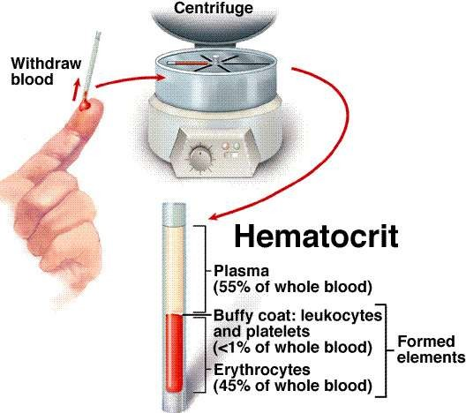
Blood Composition
Blood composed of : plasma + blood cells
Hematocrit:
the percentage of total blood volume that blood cells occupy.
normal value male: 40-50%
female: 37-48%
newborn: 55%
Blood is made up of four major components:
Plasma: the liquid portion. Contains dissolved nutrients, hormones, gases.
Red blood cells: transport oxygen
White blood cells: defenses against invaders
Platelets: help form blood clots

Slide 93
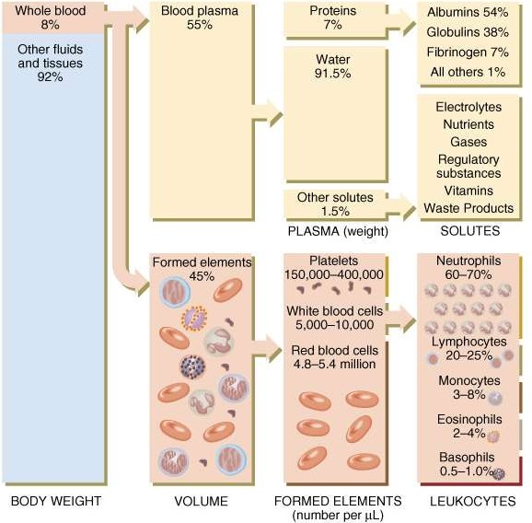
Blood Components

Slide 94
Chemical Composition of Plasma
 | Plasma | Interstitial fluid | Intracellular fluid
Na⁺ | 142 | 145 | 12
Cl⁻ | 104 | 117 | 4
_{Ca}++ | 2.5 | 2.4 | <0.001
_{K}+ | 4.3 | 4.4 | 139
PO₄⁻ | 2 | 2.3 | 29
Protein | 14 | 0.4 | 54
H₂O 90 - 91%

Slide 95
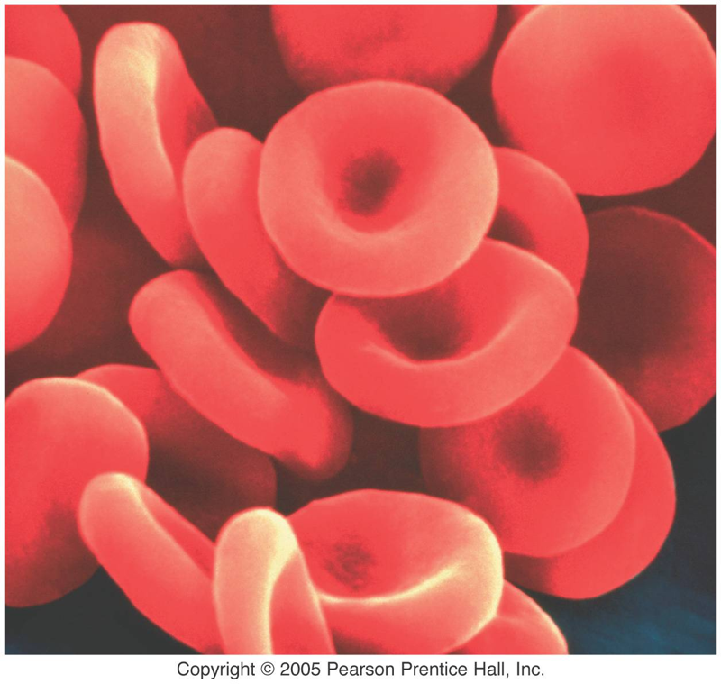
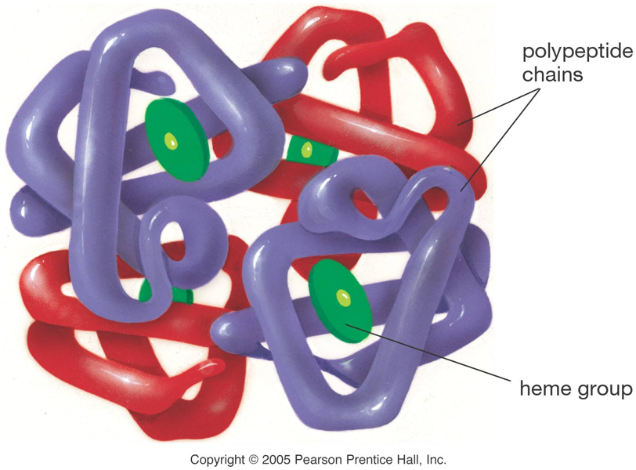
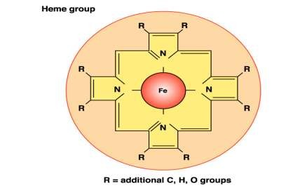
Blood Cells and Circulation
Blood cells are erythrocyte (red blood cell, RBC), leukocyte (white blood cell, WBC) and thrombocyte (platelet, P).
Red Blood Cells (Erythrocytes):
RBCs are disc-shaped cells that lose their nucleus at maturity.
Make up about 99% of the blood’s cellular component.
Red color is due to hemoglobin.
Hemoglobin is a complex protein made up of four protein strands. Iron is used to form heme groups.
Each hemoglobin molecule can carry four oxygen atoms. The presence of oxygen turns hemoglobin bright red.
RBC
Hemoglobin

Slide 96
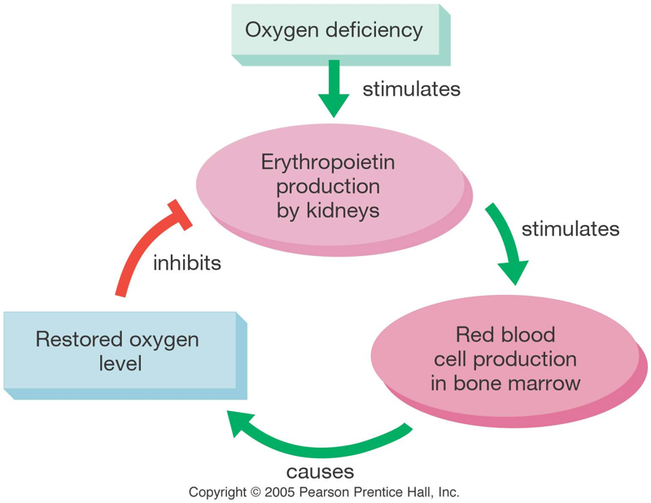
Functions and Lifespan of RBC
Functions:
RBC can be used for transportation of O₂ and CO₂ in the blood.
RBC can be served as pH buffer.
Lifespan:
Life-span of RBC is 120 days, about 4 months, each RBC circulates 27 km
averagely in vessels, short life-span for aged RBC.
RBCs live about 4 months. Iron from hemoglobin is recycled in the liver
and spleen.
The hormone erythropoeitin, made by the kidneys, stimulates the production
of RBCs in red bone marrow.

Slide 97
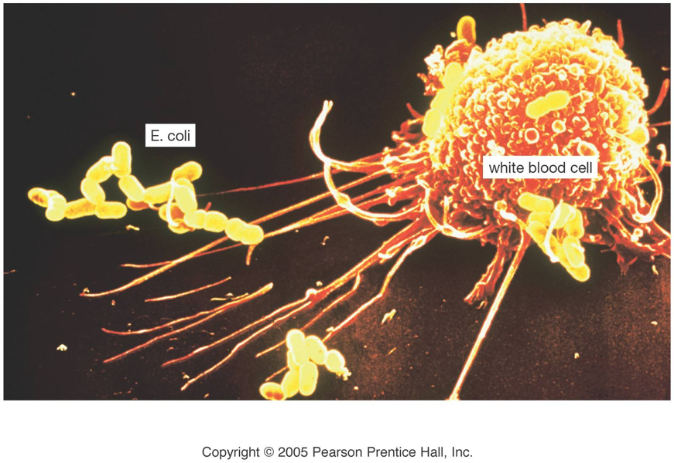
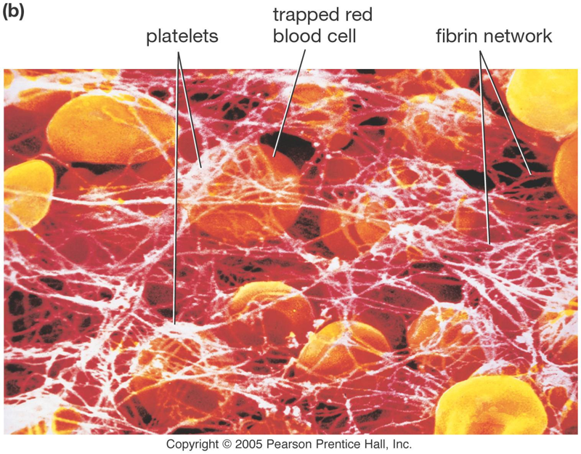
White Blood Cells and Platelets
White Blood Cells:
White blood cells defend against disease by recognizing proteins that do not
belong to the body.
White cells are able to ooze through the walls of capillaries to patrol the tissues
and reach the lymph system.
Platelets:
Platelets are cell fragments used in blood clotting.
Platelets are derived from megakaryocites. Because they lack a nucleus, platelets
have a short lifespan, usually about 10 days.

Slide 98
Lifespan of White Blood Cell
Birth place: bone marrow, originating from hemopoietic stem cells, and leukopoiesis process is similar to RBC.
Leukopoiesis, differentiation and growth are influenced by hemopoietic growth factor, HGF which are glycoprotein
secreted by lymphocyte, monocyte- macrophage, fibrous cell and endothelial cell.
Life span: several hours to 3 or 4 days.
Leukocyte breakage: site are liver, spleen and lymphatic node.
Pus or purulence forming
Leukopoiesis is a form of hematopoiesis in which white blood cells (WBC, or leukocytes) are formed in bone marrow
located in bones in adults and hematopoietic organs in the fetus.

Slide 99
Blood Coagulation
The process of blood flow from flowing liquid to gel or gelatin.
Serum: Light yellow fluid after blood coagulation.
Difference between serum and plasma mainly consists in no fibrinogen in serum.
Blood coagulation is a series of complicated biochemical reactions
with various enzymes.
Blood clotting factor: Material which are directly involved in blood coagulation.
There are 12 factors named Roman numerals, except Ca²⁺, phospholipid, other factors being protein, and except FIII (TF),
others are in fresh plasma synthesized by liver with VitK .
Blood clotting enzymes have two type: inactive and activated type [FII, FVII, FIX, Fx, FXI, FXII, FXIII].

Slide 100

Blood Coagulation
Intrinsic pathway of blood coagulation: All blood clotting factors involved in blood coagulation come from blood.
Eyewinker surface with negative charges (collagenin) on the endothelium of blood vessel activates blood FXII as
beginning of coagulation named surface activation.
Extrinsic pathway of blood coagulation: Stimulus activates tissue factor (FIII) as beginning of coagulation.
Extrinsic pathway of blood coagulation is faster than intrinsic pathway of blood coagulation because its steps are more simple.
Basic steps of blood coagulation:
Platelets aggregate at the site of a wound.
Broken cells and platelets release chemicals to stimulate thrombin production.
Thrombin converts the protein fibrinogen into sticky fibrin, which binds the clot.

Slide 101
Practice Questions
Discuss the main functions of Blood
List and discuss about the important components of blood
What are RBCs and what is their lifespan
What are WBCs and platelets?
Explain the process of blood coagulation

Slide 102
References
State University of New York (February 3, 2014). "The Circulatory System". suny.edu. Archived from the original on February 3, 2014.

Slide 103
Cardiovascular System: Physiology of Heart
School of Basic and Applied Sciences
Course Code : BBS01T1008 Course Name: Biology For Engineers
Name of the Faculty: Dr. Chandreyee Saha Program Name: B.Tech. Sem-I

Slide 104
Objectives
Structure of Heart
Heart Valves
Heart Chambers
Physiology of Circulation

Slide 105

Heart and Blood Circulation

Slide 106

Walls of the Heart
The heart is enclosed in a protective sac, the pericardium, which
also contains a small amount of fluid.
The wall of the heart is made up of three layers:
1. Epicardium (visceral pericardium) – serous membrane covering
heart
2. Myocardium – thick muscular layer and fibrous skeleton made
up of network of collagenous and elastic fibers
3. Endocardium – smooth inner lining of the heart lined with
endothelium cells

Slide 107


Chambers of the Heart
The four chambers of the heart are right atrium, left atrium and right ventricle, left ventricle
Anterior View
Posterior View

Slide 108


Valves of the Heart
Heart Valves are paper thin muscular flaps which opens and closes and helps in the unidirectional flow of blood in the heart
The 4 Heart Valves are: Mitral valve (bicuspid valve), Tricuspid Valve, Aortic valve and Pulmonary Valve

Slide 109



Valves of the Heart
Mitral and tricuspid Valves are called atrioventricular valves which control blood flow from atria to ventricles
Aortic and Pulmonary Valves controls blood flow out of the ventricles
Mitral and Aortic Valves are in the left heart and Tricuspid and Pulmonary Valves are towards the right
Right AV Valve
Left AV Valve
Aortic/Pulmonary Valve

Slide 110

Valves of the Heart
The papillary muscles extend from the walls of the heart to valves by cartilaginous connections called chordae tendina
It takes about 0.03–0.04 seconds for the impulse to travel from the bundle of His to the ventricular muscle.

Slide 111



Physiology of Circulation in Heart
Lungs
Pulmonary
capillaries
Pulmonary
circulation
There are two circuits of blood circulation in the hearts:
R. ventricle ⇨ Pulmonary arteries ⇨
Lungs ⇨ Pulmonary veins ⇨ L. atrium
Pulmonary
arteries
Pulmonary
veins
Right side of
heart
= O2-poor blood
= O2-rich blood

Slide 112

Physiology of Circulation in Heart
AV valves open and Pulmonary valves close
blood flows from atria to ventricles
ventricle pressure continues to rise momentarily before
ventricle ejection

Slide 113

Valves of the Heart
Pulmonary valves open and AV valves close
Ventricle ejection; ventricle pressure drops

Slide 114
Pathway of Blood Flow Through Heart
Systematic Circulation:
Systemic circulation carries oxygenated blood from the left ventricle, through the arteries, to the capillaries in the tissues
of the body.
From the tissue capillaries, the deoxygenated blood returns through a system of veins to the right atrium of the heart
The systemic circulation provides the functional blood supply to all body tissue. It carries oxygen and nutrients to the cells and
picks up carbon dioxide and waste products.
Pulmonary Circulation:
The pulmonary circulation is the portion of the circulatory system which carries deoxygenated blood away from the right ventricle, to the lungs, and returns oxygenated blood to the left atrium and ventricle of the heart

Slide 115

Pathway of Blood Flow Through Heart

Slide 116
Practice Questions
Explain the basic structure of heart
Discuss the nature of walls in heart
How many valves are present in the heart and what are their functions?
Explain diagrammatically the physiology of blood circulation in heart

Slide 117
References
National Heart Lung and Blood Institute Fact Book, Fiscal Year 2006. Bethesda, Md: National Heart Lung and Blood Institute, National Institutes of Health; 2006. [12 April 2011]

Slide 118
Heart: Functions, Cardiac Cycle and Electrical Activities
School of Basic and Applied Sciences
Course Code : BBS01T1008 Course Name: Biology For Engineers
Name of the Faculty: Dr. Chandreyee Saha Program Name: B.Tech. Sem-I

Slide 119
Objectives
Heart Functions
Cardiac Cycle
Conduction System
Electrical Activities and Problems of the Heart

Slide 120

Cardiac Cycle and Electrical Conduction in Heart

Slide 121
Functions of the Heart
Transport O₂ to tissues and remove waste
Transport nutrients to tissues
Regulation of body temperature
Heart - Pumps blood
Arteries and arterioles - Carry blood away from heart
Capillaries - Exchange nutrients with tissues
Veins and venules - Carry blood toward heart

Slide 122

Cardiac Cycle
Systole
Contractile phase of heart
Electrical and mechanical changes
E.g. blood pressure changes
E.g. blood volume changes
Diastole
Relaxation phase of heart
Takes twice as long as systole
E.g. resting HR = 60
Systole = 0.3 s
Diastole = 0.6 s

Slide 123
Arterial Blood Pressure
Expressed as systolic/diastolic
Normal – 120/80 mmHg
High – 140/90 mmHg
Systolic pressure (top number)
Pressure generated during ventricular contraction
Diastolic pressure
Pressure during cardiac relaxation
Pulse Pressure (PP)
Difference between systolic and diastolic
PP = systolic – diastolic
Mean Arterial Pressure (MAP)
Average pressure in arteries
MAP = diastolic + 1/3 (systolic – diastolic)

Slide 124

Arterial Blood Pressure Factors

Slide 125

Electrical Activity of the Heart
Contraction of heart depends on electrical stimulation of myocardium
Impulse is initiated on right atrium and spreads throughout the heart
May be recorded on an ECG
The sinoatrial node (SA node), also known as sinus node, is a group of cells
located in the wall of the right atrium of the heart
These cells have the ability to spontaneously produce an electrical impulse
(action potential), that travels through the heart via the electrical conduction
system causing it to contract.
In a healthy heart, the SA node continuously produces action potential, setting
the rhythm of the heart and so is known as the heart's natural pacemaker.
SA node contain fast sodium channel and slow calcium sodium(Ca-Na) leaky channels
through these channel calcium and sodium continuously transmitted in the SA node cells
that cause depolarization of cells and create action potential in SA node continuously due
to this continuous generation of action potential S.A node is called pacemaker

Slide 126

Sympathetic and Parasympathetic Regulations of the Heart
1. Vagus nerve release acetylcholine neurotransmitter at ending of nerve and
increase permeability of K⁺ efflux and increase negativity inside nerve -65 to
-70 mv in compare to resting potential -55 mv and cause hyperpolarization
which decrease heart contraction
2. Mechanism of sympathetic effect: Sympathetic neuron release norepinephrine
which increase S.A node discharge by increasing permeability of slow Ca–Na
channel and increase velocity of conducting fiber as a result increase action
potential and increase force of contraction of heart

Slide 127
Sympathetic and Parasympathetic Regulations of the Heart
Period of Isovolumic/isometric contraction: 0.02-0.03 s time is required to develop pressure in right ventricle to push
Semilunar valve during contraction
4. Period of ejection: 1/3 time for 70 % blood 2/3 s for 30 % blood pump from left ventricle
5. End Diastolic volume: During diastole of ventricle the volume of each ventricle is 120ml called End Diastolic volume
6. Stroke volume: When ventricle systole 70 ml blood decrease called stroke volume
7. End systolic volume: After one systole of ventricle remaining blood in ventricle is 40-50 ml is called End systolic volume

Slide 128

Electrocardiography
Electrocardiography (ECG) is the process of recording the electrical activity of the heart over a period of time using electrodes
placed over the skin.
These electrodes detect the tiny electrical changes on the skin that arise from the heart muscle's electrophysiologic pattern of
depolarizing and repolarizing during each heartbeat
The overall magnitude of the heart's electrical potential is then measured from
twelve different angles
The graph of voltage versus time produced is an electrocardiogram.
The P wave, which represents the depolarization of the atria
The QRS complex, which represents the depolarization of the ventricles
T wave, which represents the repolarization of the ventricles.

Slide 129
Electrocardiography
There are three main components to an ECG:
P is the atrial systole contraction pulse
Q is a downward deflection immediately preceding the ventricular contraction
R is the peak of the ventricular contraction
S is the downward deflection immediately after the ventricular contraction
T is the recovery of the ventricles

Slide 130
Problems of the Heart
Heart failure (HF), also known as chronic heart failure (CHF), is when the heart is unable to pump sufficiently to maintain
blood flow to meet the body's needs. Signs and symptoms of heart failure commonly include shortness of breath, excessive
Tiredness and leg swelling
Common causes of heart failure include coronary artery disease including a previous myocardial infarction (heart attack), high
blood pressure, atrial fibrillation, valvular heart disease, excess alcohol use, infection
Chronic obstructive pulmonary disease (COPD) is a type of obstructive lung disease characterized by long-term breathing
problems and poor airflow.
Tobacco smoking is the most common cause of COPD, with factors such as air pollution and genetics playing a smaller
role. Eventually everyday activities, such as walking or getting dressed, become difficult.
Chronic bronchitis and emphysema are older terms used

Slide 131
Practice Questions
Explain the concept of systole and diastole of heart
Explain the electrical conduction of heart
What are the factors responsible for irregularities in blood pressure?
What is Electrocardiography? Discuss its significance with relation to heart
Discuss about some of the common heart problems

Slide 132
References
National Heart Lung and Blood Institute Fact Book, Fiscal Year 2006. Bethesda, Md: National Heart Lung and Blood Institute, National Institutes of Health; 2006. [12 April 2011]

